Slide 1

Software Quality Assurance: Techniques and Tools
By: Matt Heinzelman

Slide 2
Overview
What is Software Quality Assurance?
Standards and Procedures
  Requirement Standards
  Design Standards
  Code Standards
  Documentation Standards
Techniques
  Audit
Tools
  Configuration and Problem Management
  Testing Software
Benefit of Software Quality Assurance in Projects

Slide 3
What is Software Quality Assurance?
Used to Monitor and Improve the Software Development Process
Making Sure That Standards and Procedures are Followed
Ensures that Problems are Found and Dealt with
Orientated to ‘Prevention’

Slide 4
What is SQA?
Planned and Systematic Approach to the Evaluation of the Quality of and Adherence to:
  Software Product Standards
  Processes
  Procedures
Assures that Standards and Procedures are Established and Followed throughout the Software Development Process
IEEE ISO 9000 Certified

Slide 5
Standards and Procedures
Framework for which Software Evolves
Standards
  Established Criteria to which Software Products are Compared
Procedures
  Established Criteria to which Development and Control Procedures are Followed
SQA is based on the Following of Standards and Procedures

Slide 6
Standards and Procedures
Proper Documentation of Standards and Procedures is Necessary for SQA
SQA Activities of Process Monitoring, Product Evaluation, and Auditing rely on these Standards and Procedures
Any number of different Standards and Procedures can be used on a given system

Slide 7
Standards and Procedures
Requirement Standards
  Specify the Form and Content of how Requirements are defined in a System
  Establishes a System of how to write a Requirement
    Short Phrase Describing Requirement
    Elaborate into more Detail
  Use a Numbering System for the Major Requirements and Sub-Requirements
  Many Major Companies have Software to aid in the Requirement Writing Process

Slide 8
Standards and Procedures
Design Standards
  Specify the Content and Form of how Design Documents are Developed
  Provide Rules and Methods to Transfer:
    Software Requirements to Software Design
    Software Design into Software Design Documentation
  Many Major Companies have Design Development Software to aid in the Process

Slide 9
Standards and Procedures
Code Standards
  Specify what Language the Code is written in and Define any Restrictions on Language Features
  Code Standards Define:
    Legal Language Structures
    Style Conventions
    Rules for Data Structures and Interfaces
    Internal Code Documentation
  Using Methods such as “Peer Reviews”, “Buddy Checks”, and Code Analysis can Enforce Standards

Slide 10
Standards and Procedures
Code Standards
  A good thing but too many will Force Productivity and Creativity to Suffer
  Examples of Good Code Standards:
    Reduction or Elimination of Global Variables
    Function and Method Sizes should be Minimized
    Each Line of Code should be Seventy Characters Maximum
    One Code Statement per Line
    Etc…

Slide 11
Standards and Procedures
Documentation Standards
  Specify Form and Content for Planning, Control, and Product Documentation
  Provide Consistency throughout a System
  Documentation can be written in any form
  Each Practice should be Documented so it can be Repeated or Changed later if needed

Slide 12
Standards and Procedures
Documentation Standards
  Everything in a System should be Documented including:
    Specifications
    Designs
    Business Rules
    Inspection Reports
    Configurations
    Code Changes
    Test Plans
    Test Cases
    Bug Reports
    User Manuals
    Etc…
  A System should be used to easily find and obtain Information about a System and what Documentation will have that piece of Information

Slide 13
Techniques
Audit
  The Major Technique used in SQA
  Perform Product Evaluation and Process Monitoring
  Performed Routinely throughout the Software Development Process
  Look at a Process and/or Product in depth and compare to Established Standards and Procedures
  Purpose is to assure that:
    Proper Control Procedures are being followed
    Required Documentation is maintained
    Developer’s Status Reports accurately reflect the status of the activity

Slide 14
Techniques
Audit
  Used to:
    Review Management
    Technical Processes
    Assurance Processes
  Provide an indication of the Quality and Status of the Software Product
  SQA Product is an Audit Report to Management consisting of Findings and Recommendations to bring development up to par with Standards and Procedures

Slide 15
Tools
Many different Tools on the market today for SQA
Each Tool works differently but accomplishes same goal:
  Help Improve the Development Process of a Computer System
Look at two different Tools:
  Configuration and Problem Management
    Borland StarTeam and Lucent Technologies Sablime
  Testing Software
    Programming Research QA C++ and Parasoft Jtest

Slide 16
Configuration and Problem Management
Borland StarTeam
  Can be Tailored to any Software Development Team
  Can be used with various work teams based on Size, Distribution, and Work Style
  Manage the whole Development Process using a Centralized Control of Project Assets
    Promotes team communication and collaboration
  Offers:
    Integrated Change Management
    Threaded Discussion
    Project and Task Management
  All Project Modules stored in one Repository
  Uses Windows Server Interface, but is Multiplatform on each of the Clients

Slide 17
Borland StarTeam
StarTeam Enterprise Advantage
  Used for large, widely distributed teams to work on Enterprise-Level Projects
  Supports the Whole Development Cycle with:
    Integrated Requirements Management
    Change Management
    Defect Tracking
    File Versioning
    Threaded Discussions
    Project and Task Management
  Offers Project Trend Analysis and Reporting

Slide 18
Borland StarTeam
StarTeam Enterprise Advantage
  Has four Unique Features
    Has Search and Query Capabilities across multiple objects an repositories for easy reuse and sharing
    MPX Server provides Multicast Communication to keep Users Up-To-Date and the Project current
    Cache Agent that supports Distributed Development with Multisite Repositories
    A Web Addition

Slide 19
Borland StarTeam
StarTeam Enterprise
  Middle-Road Version
  Best suited for Medium-to-Large Development Teams
  Uses a Unified Repository to manage shared and reusable components
  Versions and Automatically Tracks Changes to help Monitor Project Status
  Web Client Support
    Completely Browser-Based
  Enterprise Web Edition allows access to StarTeam without using an Installed Client, increasing Client choices

Slide 20
Borland StarTeam
StarTeam Standard
  Smallest, or Standard Version
  Entry-Level Tool with components for File Versioning, Defect Tracking, and Threaded Discussions
  Helps small Project Groups efficiently manage change across the Development Lifecycle
  Key Development Tasks:
    File Check-In, Check-Out and Labeling
    Change Request Functionality
    Able to Roll-Back to Previous File Versions

Slide 21
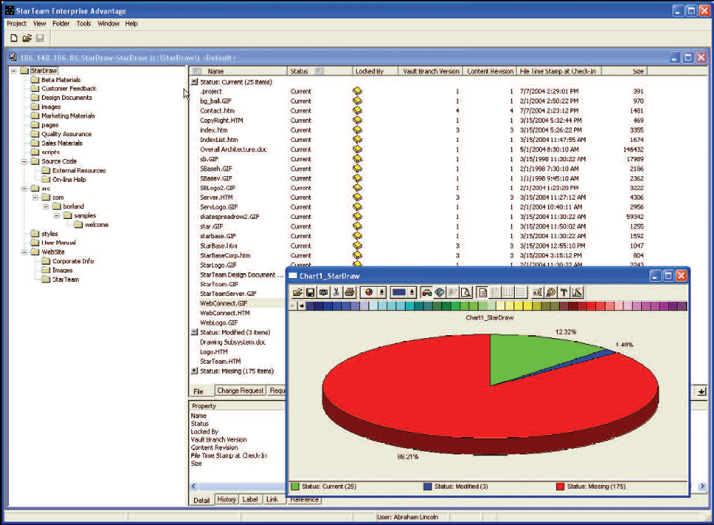

Slide 22
Configuration and Problem Management
Lucent Technologies Sablme
  Integrated Version Control and Change Management to help improve Quality and shorten Release Cycles
  Can be used on any size Project with any number of People
  Supports Concurrent Development
    Files can be worked on by two or more developers at the same time
    The files are automatically merged
  Developed by Bell Labs and is a Multiplatform Software
  Can be Incorporated into Multiple Development Environments
  Analysis tools can be incorporated into many different Spreadsheet Programs

Slide 23
Lucent Technologies Sablime
Development Process is built around the Modification Request
Any changes that are proposed must be done by creating an MR
When the MR is reviewed, it can be:
  Deferred
  Killed
  Assigned for Study
  Accepted for Implementation in one or more codelines
Sablime tracks changes using MRs and makes sure that all changes are done by Implementation Time

Slide 24
Lucent Technologies Sablime
Program Versions are based on the MR states
Each MR is assigned to one or more Project Members with a Priority and Due Date
If a MR is too big, then it can be divided into smaller tasks and Independently Assigned, Tracked, and Managed
As an MR passes through its Life Cycle, Project Members are notified through e-mail.
Sablime keeps track of Who, When, and Why each action was taken.

Slide 25
Lucent Technologies Sablime
Benefits of using Sablime
  Helps improve product quality and shortens release cycles
  Supports an out-of-the-box process model
  Tracks, coordinates and integrates product changes and change requests
  Helps prevent fixed bugs from getting reintroduced
  Enables you to reconstruct versions sent to customers

Slide 26
Lucent Technologies Sablime
Benefits
  Makes project status and source files accessible to all team members, even when geographically distributed
  Enables managers to control and characterize contents of each release, and track release status
  Enables testers to see what features or fixes are ready for testing, and to review the requirements, notes, and implementation associated with each change request
  Enables integrators to create consistent product versions automatically, based on readiness for integration

Slide 27
Lucent Technologies Sablime
Provides Comprehensive Configuration Management and Version Control
Key Features of Sablime
  Coordinates change requests and actual changes
  Supports multiple active codelines (releases) per product
  Supports concurrent development, with less need for merging
  Detects dependencies automatically
  Integrates with the Eclipse development platform
  Integrates with Visual Studio and other IDE’s
  Integrates with Excel, enabling status reporting and management

Slide 28
Lucent Technologies Sablime
Key Features of Sablime
  Guides teams to consistent results using defined roles and workflow with email notification
  Scales easily from small to large objects
  Supports local and web-based users
  Allows scripting and customization
  Easy to learn and use
  Simple to install and maintain
  Does not require dedicated hardware
  Available on UNIX, Linux, and Windows

Slide 29
Testing Software
Programming Research QA C++
  Ensures Code Quality while Enhancing Productivity
  Can be quickly Integrated almost everywhere
  Provides an automated environment to Introduce and Enforce Custom Coding Standards
    Set by the Software Development Company
    Required by Customers
  Provides Documentation to prove this
  Can detect many different problems and defects like:
    Language Implementation Errors
    Inconsistencies
    Obsolescent Features
    Coding Standard Violations

Slide 30
Programming Research QA C++
Detecting defects and problems in code earlier can prevent delays later
Reports many Industry-Standard Code Metrics into graphs, diagrams, and HTML output.
Reports can be exported to be used in Microsoft Office or StarOffice to Analyze, Share, or Present information
Any problem discovered by QA C++ is shown in a Message Browser with a Drill-Down Environment

Slide 31
Programming Research QA C++
QA C++ explains why problems it discovers need to be corrected and then provides examples on how to fix them
Product Highlights:
  Identifies coding problems early in the development cycle
  Accelerates the code review process – improves teamwork
  Ensures quality code and coding standard compliance
  Educates and raises programmer awareness
  Reduces the risk of program failure
  Enhances reliability, portability, and maintainability
  Lowers software development costs – increases productivity
  Improves time-to-market while reducing costs
  Allows instant and repeatable code audits and reviews
  Delivers unmatched technology & strong ROI

Slide 32
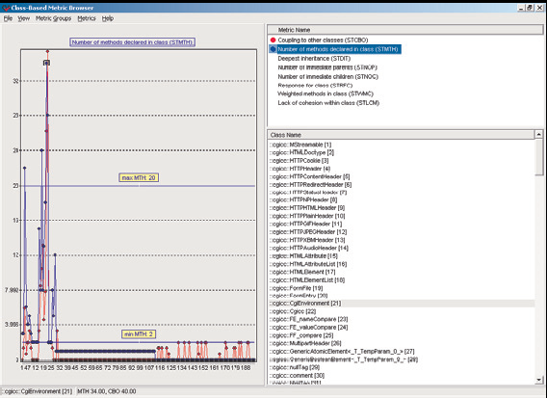

Slide 33
Testing Software
Parasoft Jtest
  Java Unit Testing and Coding Standard
  Improves Java Code Reliability, Security, Performance, and Maintainability
  Checks code with over 500 different built in Development Rules
  Can correct many violations automatically
  User Defined Code Guidelines can be produced without using code; either Graphically or Automatically

Slide 34
Parasoft Jtest
Exposes Reliability Problems
  Examines each class, then generates and executes JUnit Test Cases designed to achieve High Coverage and Expose Uncaught Runtime Exceptions
Exposes Functionality Problems
  Can add and execute User-Defined Test Cases
  Test Case Sniffer can monitor a running application and generate JUnit Test Cases to monitor behavior
Automated Regression Testing
  Identifies problems introduced by code modifications
QA Team Members can use JTest to identify critical problems before release/deployment

Slide 35
Parasoft Jtest
Analyzes Code in two ways
  Verifies Code Complies with Development Rules for Preventing Functional Errors, Security Vulnerabilities, Performance Problems, and Pitfalls
  Jtest Automatically generates JUnit Test Cases
Test findings are reported as a Prioritized Task List
Test Cases can be added:
  Automatically using Test Case Sniffer
  Graphically
  Programmatically

Slide 36
Parasoft Jtest
Benefits to using Jtest
  Improve code reliability, functionality, security, and performance quickly and painlessly
  Obtain instant expert feedback on code quality and potential defects
  Prevent code modifications from breaking previously-verified functionality
  Perform extensive testing/debugging and more time on creative tasks
  Perform extensive testing with minimal user intervention
  Reduce the risks that cause late, over-budget, incomplete releases
  Identify errors lurking in existing applications
  Optimize code review time
  Ensure that best practices are applied consistently and uniformly across the team
  Monitor overall project quality, specific project segments, and progress toward quality goals

Slide 37
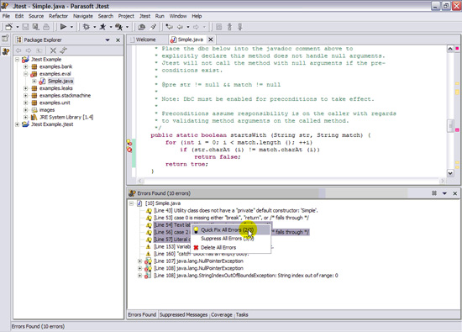

Slide 38
Benefit of Software Quality Assurance in Projects
Essential to the Development Process
Without SQA, many Development Groups would not reach their release goals/deadlines on time
Spend too much time Revisiting Requirements, Design, Code, and Documentation without SQA
Lowers time spent on mundane areas and lets more time be focused on important areas
Decreases the time from Development to Deployment
Can help catch errors before they are too costly to fix
Standards can be used across many different Projects

Slide 39
References
Hower, Rick (2006). Software QA and Testing Resource Center. Updated April 2006. Web site: http://www.softwareqatest.com/
Software Quality Assurance, NASA.
Web site: http://satc.gsfc.nasa.gov/assure/agbsec3.txt
Buchanan, Ian (2005). Borland StarTeam. Updated January 2005.
Web site: http://www.cmcrossroads.com/cgi-bin/cmwiki/bin/view/CM/StarTeam
CM Crossroads. Borland StarTeam Product Review.
Web site: http://www.cmcrossroads.com/toolspot/starteam.php
Borland Software Corporation. Borland StarTeam.
Web site: http://www.borland.com/us/products/starteam/index.html
Lucent Technologies (2006). Sablime.
Web site: http://www.bell-labs.com/project/sablime/
Programming Research, Inc (2003). QA C++ Data Sheet.
Web site: http://www.programmingresearch.com/pdfs/QAC++ -
%20DATASHEET%20FEB05%20HQ.pdf
Parasoft (2006). Jtest Data Sheet.
Web site: http://www.parasoft.com/jsp/printables/-
ParasoftJtestDataSheet.587.pdf?path=/jsp/products/-quick_facts.jsp&product=Jtest

